Slide 1
FedRL for IT Sec /
Meeting 05
28.02.2023
Jan Kreischer
Notes:
Welcome to our fourth meeting (half time meeting)

Slide 2
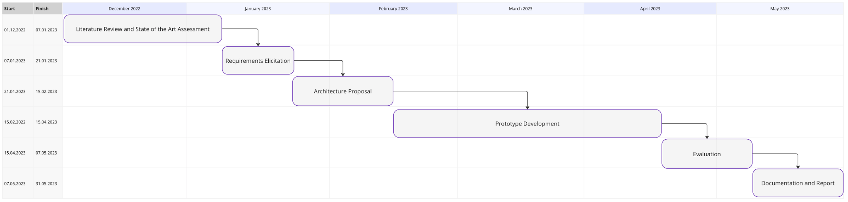
(28.03.2023)
Now
Notes:
Halftime
I worked a lot on implementing the federation and rewriting some of timos code to make it more compatible with a federated learning scenario.

Slide 3
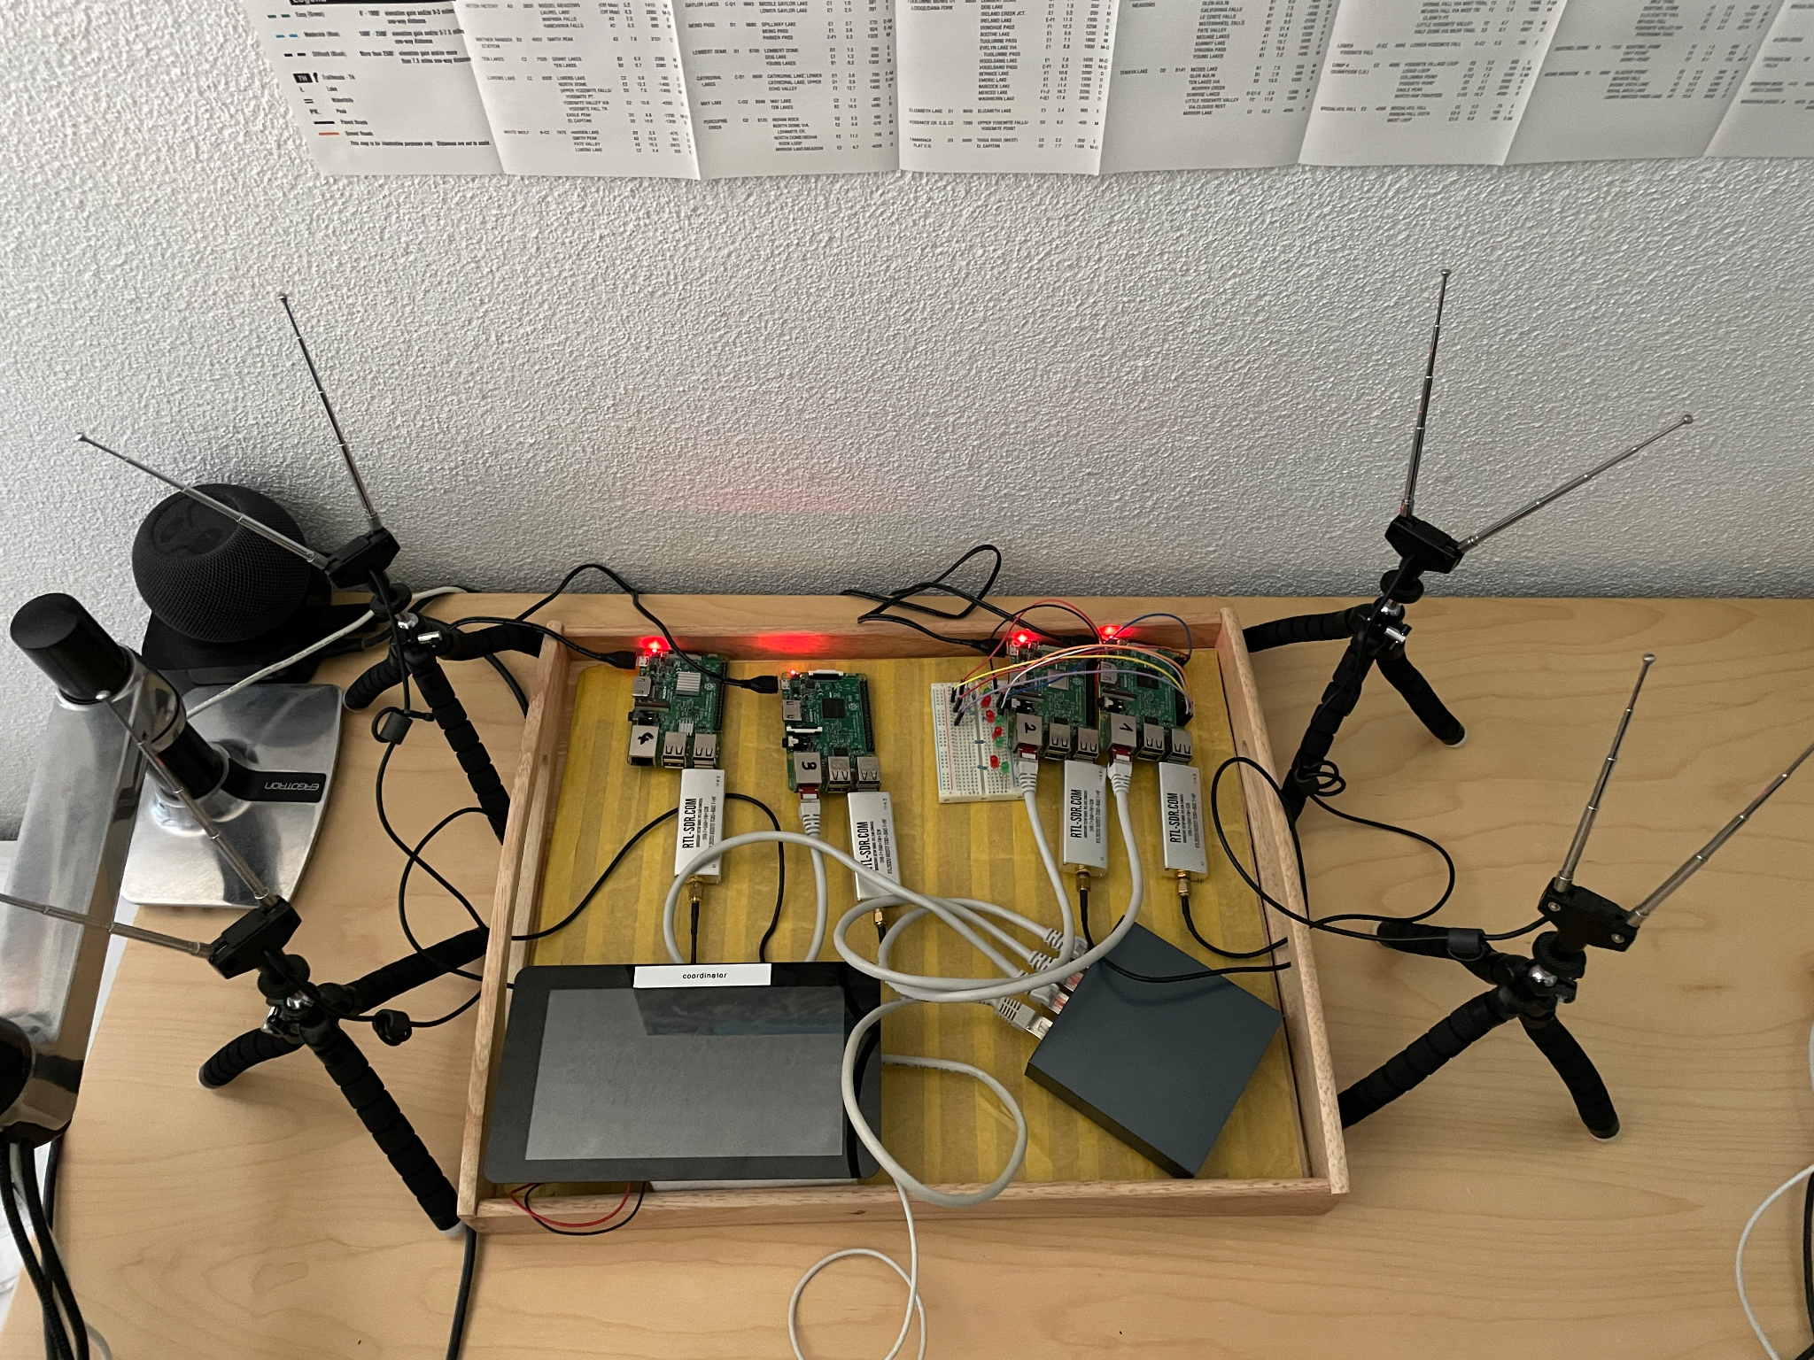
RPi Cluster Setup
Notes:
As we said this is simply the

Slide 4
Implementing Prototype 2
Running the training on a set of 5 Raspberry Pis
IBM Federated Learning
PySyft
Pytorch Distributed
Model exchange via Sockets
SCP ot .pt files
}
maybe for prototype 03
complexity
}
suitable for prototype 02
Notes:
As we said this is simply the

Slide 5
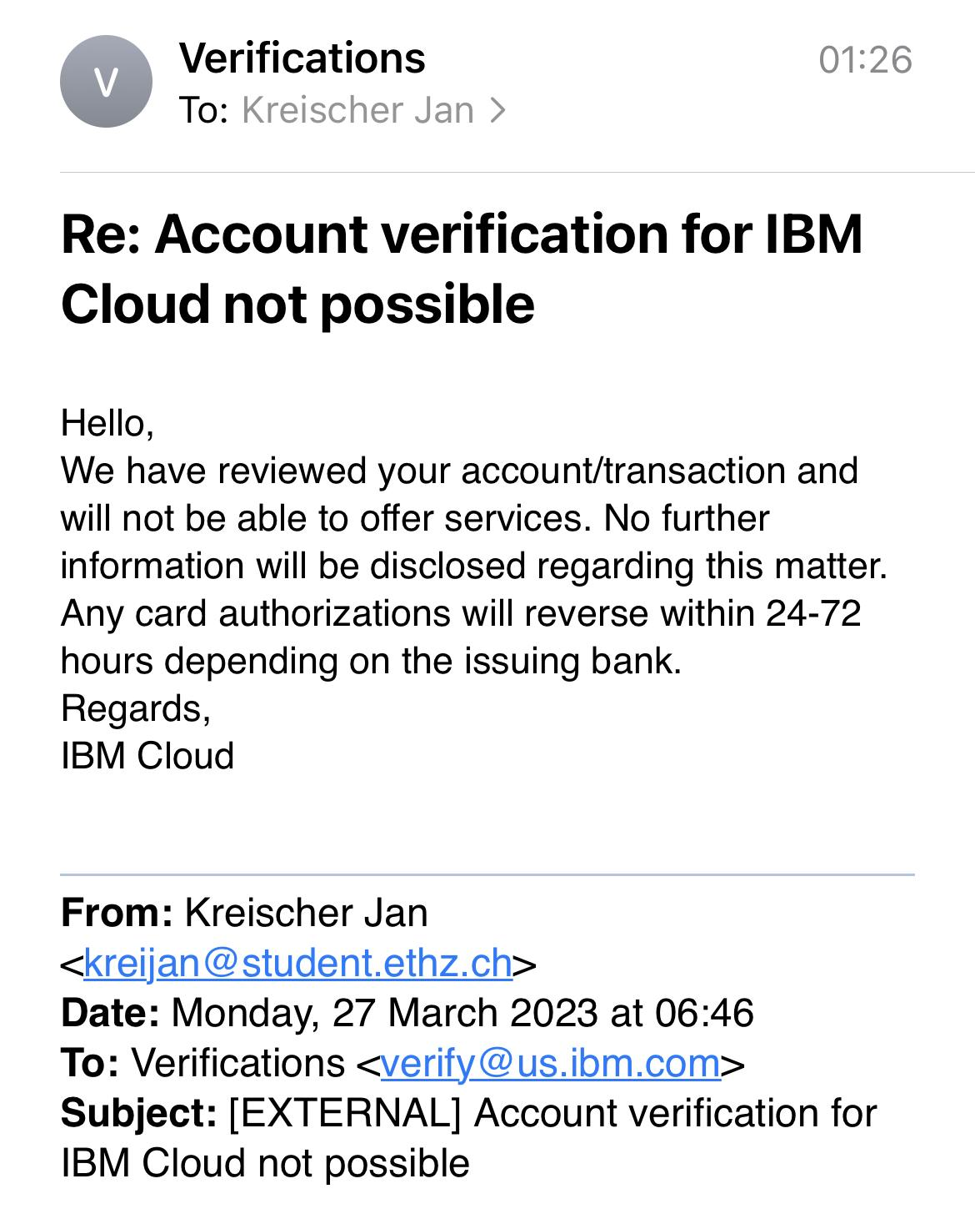
Things that did not go as planned

